Slide 1





SMART SECURE
BANK SYSTEM

Slide 2


ORGANIZATION PROJECT
Mennatallah Gamal Mohamed Abdelfatah
Mariam Nader Farouk Tadros
Manal Ali Abdallah Elsayed
Naira Ibrahim Eldosoky mohamed Ahmed
Shrouk Abdelraheem Abdallah Bahy
Supervised by:
Dr. SHAIMAA NABIL

Slide 3
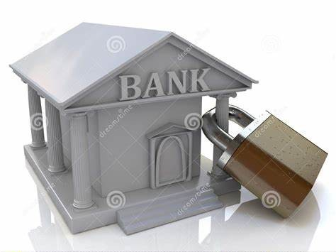
INTRODUCTION
Banks face constant threats from theft, unauthorized access, and emergencies, yet traditional security systems often lack real-time monitoring and rapid response capabilities. The Smart Bank Security System using ESP32 addresses these challenges by integrating multiple sensors (fire, smoke, DHT11 and IR) and secure keypad access into a unified IoT platform. Powered by the ESP32 microcontroller, the system enables remote supervision, instant alerts, and automated security protocols for critical areas such as counters, employee zones, and vaults. With distinct Day and Night operating modes, this solution enhances security, reduces manual oversight, and ensures swift action against potential breaches.

Slide 4

ABSTRACT
This project designs a hardware-based security system for banks using the ESP32 microcontroller integrated with multiple sensors (fire, smoke, IR, DHT11), a keypad, an LCD and Buzzer, and a simple website for real-time monitoring. The system aims to enhance bank security by:
• Monitoring environmental hazards (fire, smoke, temperature, humidity)
• Detecting unauthorized access (using IR sensors for motion detection)
• Implementing secure access control (via a keypad-based PIN system)
• Providing real-time alerts (A buzzer and LCD provide on-site alerts, while a website displays real-time sensor data remotely. The system processes sensor inputs, performs computations)

Slide 5

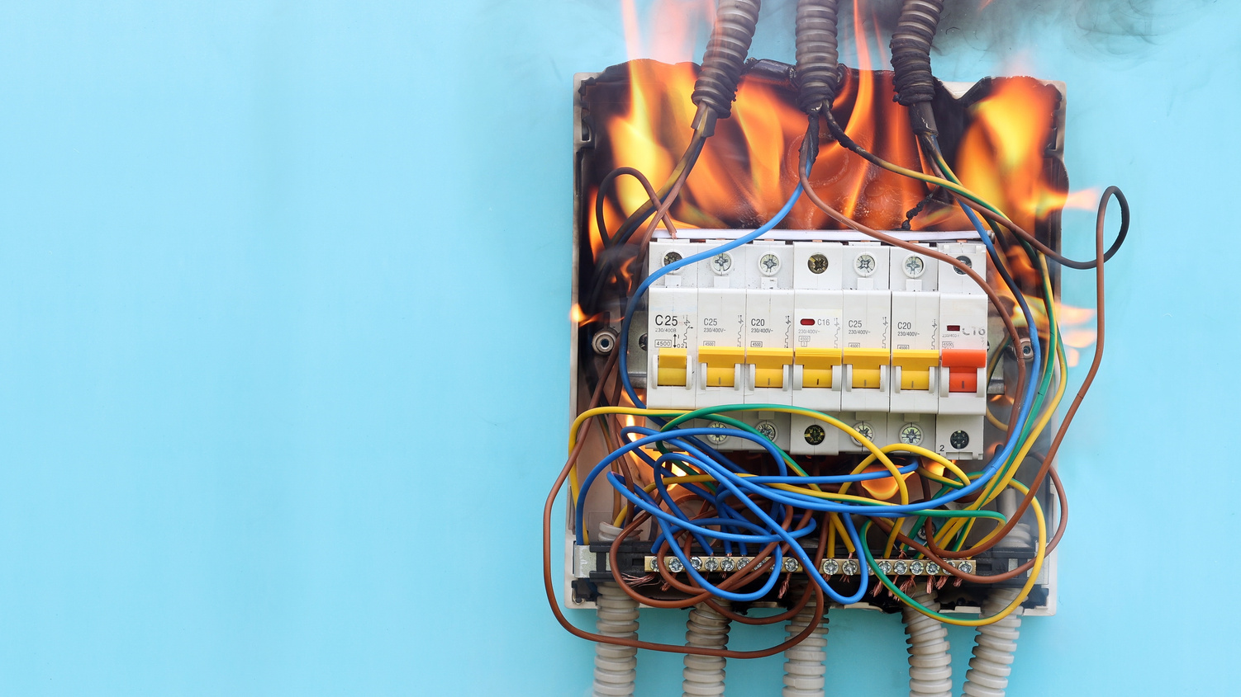

MOTIVATION
CONSTANT SECURITY THREATS
UNAUTHORIZED ACCESS
FIRE HAZARDS
ENVIRONMENTAL RISKS
(theft, break-ins)
(electrical faults, arson)
(high temperature/humidity damaging equipment)

Slide 6
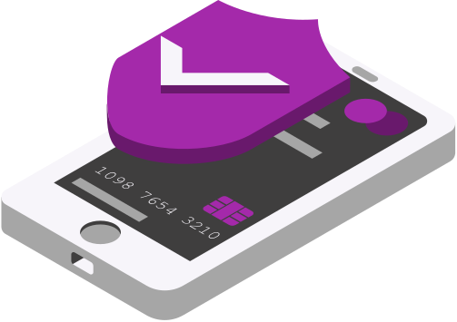
VISION
FIRE & SMOKE DETECTION
Immediate alerts using flame & smoke sensors.
STATEMENT
ACCESS CONTROL
Keypad-based PIN entry (more secure than keycards).
INTRUSION DETECTION
IR sensors detect unauthorized movement.
ENVIRONMENTAL MONITORING
DHT11 tracks temperature/humidity to prevent equipment damage.
REAL-TIME ALERTS
LCD display + Wi-Fi notifications (via ESP32).

Slide 7
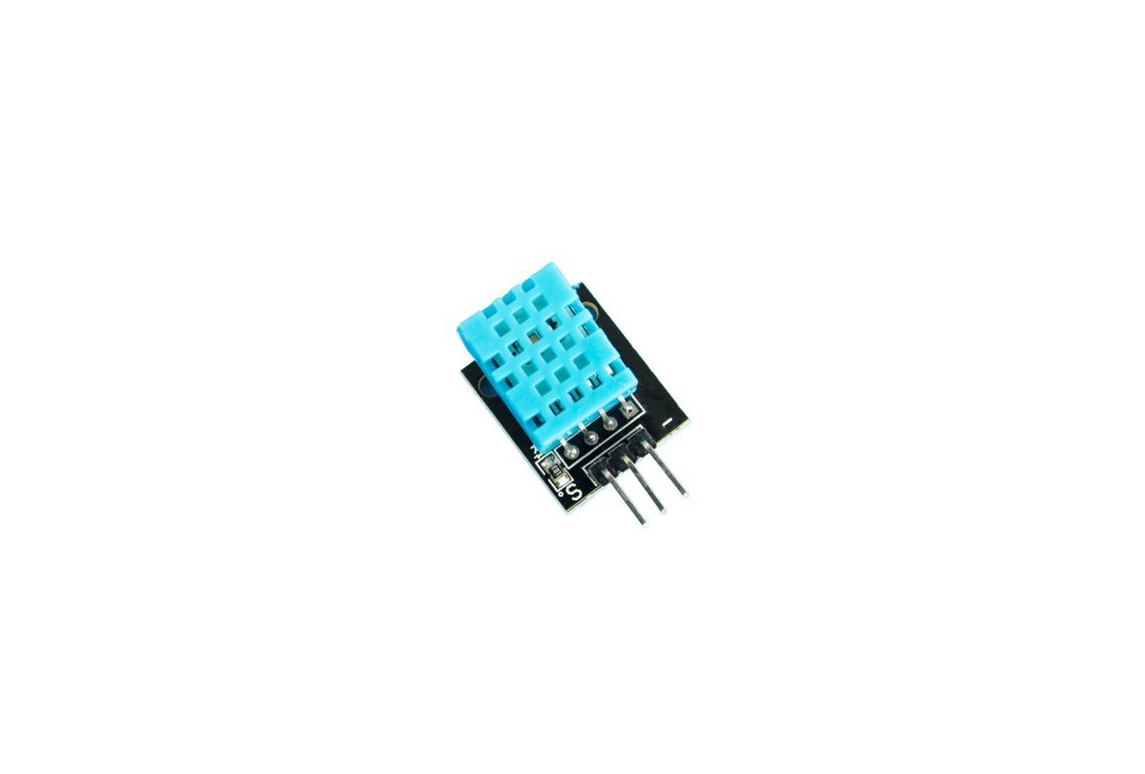
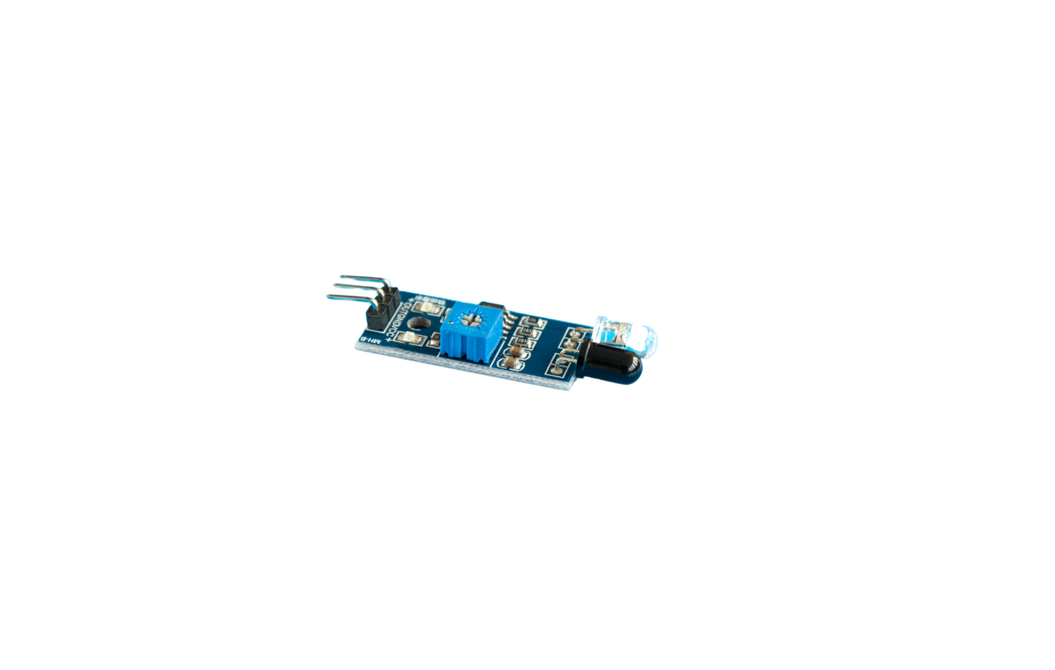
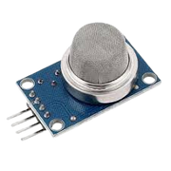
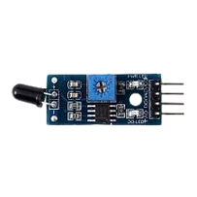
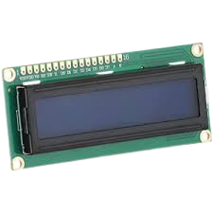
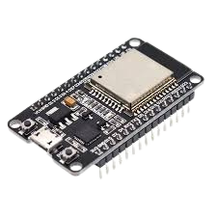
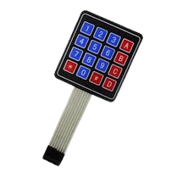
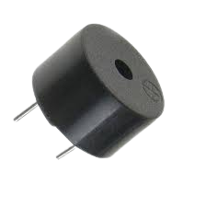
IR SENSOR
SMOKE SENSOR
DHT11
FIRE SENSOR
Detect Motion
Tempreture & Humidity
KEYBAD
LCD
Detect Smoke
Detect Fire
Enter Password
Show Password
ESP32
BUZZER
Controle all
give alert
HARDWARE
In The System

Slide 8

FLOW
CHART

Slide 9
BLOCK
DIAGRAM
IR Sensor
Buzzer
Fire Sensor
Micro controller
LCD
Smoke Sensor
DHT11 Sensor
Website
KeyPad

Slide 10
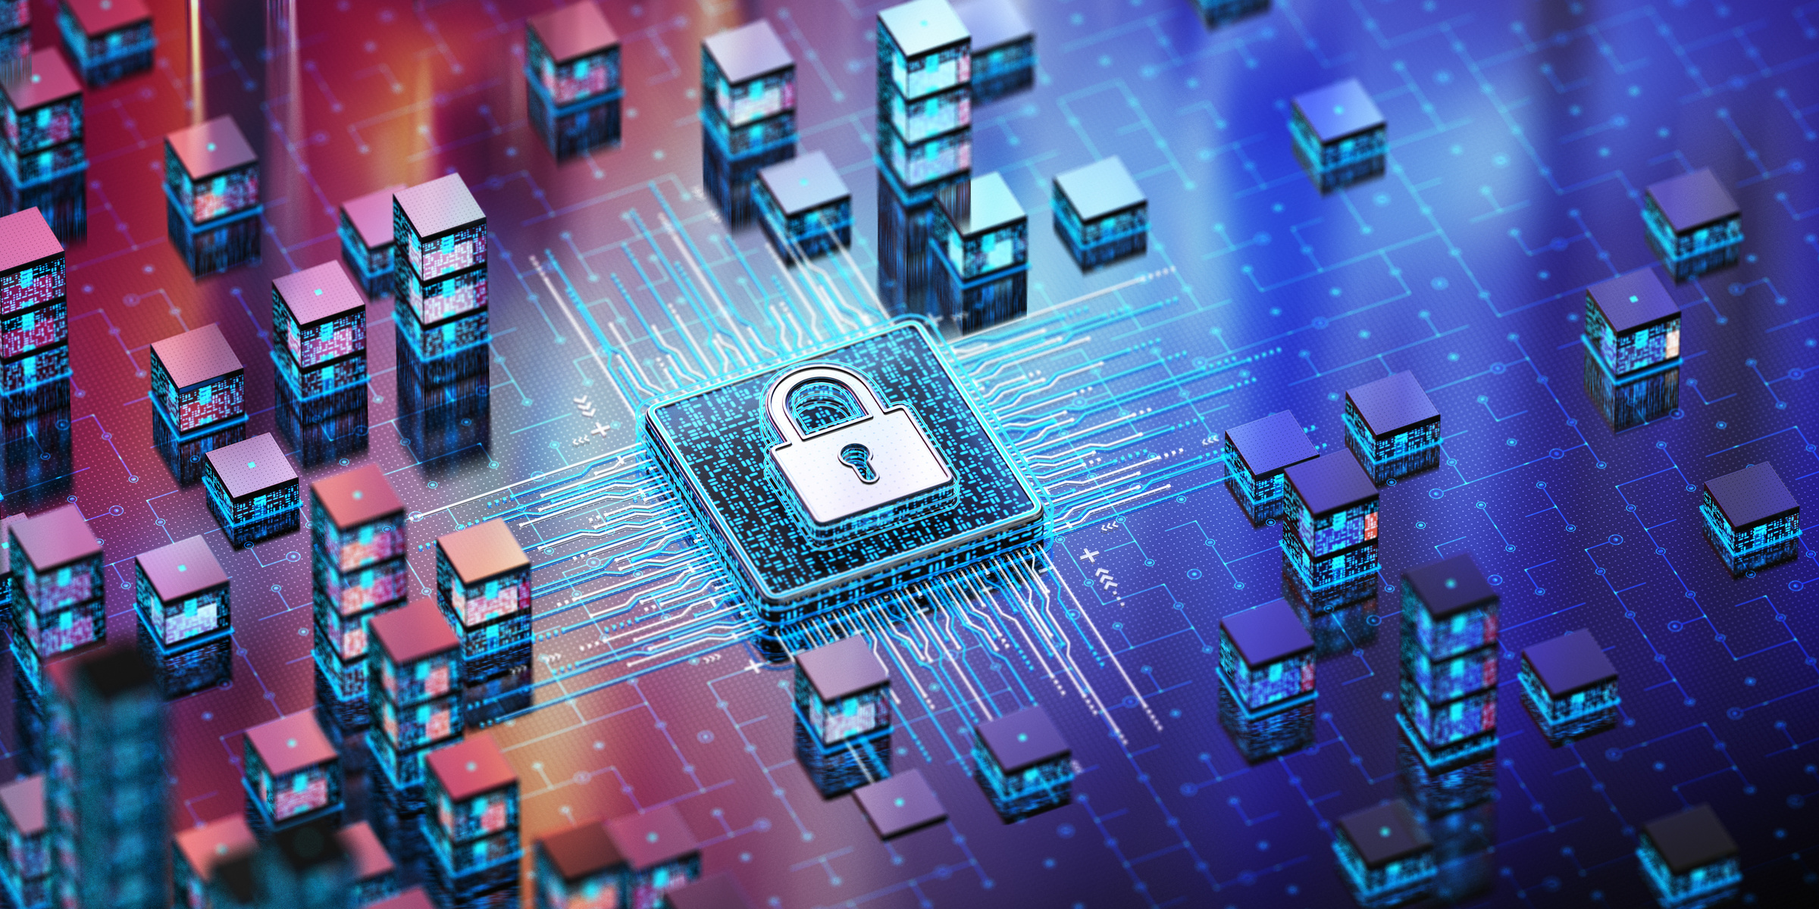
RELATION
COURSE MATERIAL
Internal Memory Technology: The ESP32’s SRAM stores sensor data and program variables, with error-checking mechanisms to ensure reliability.
External Memory: Sensor logs could be stored on an SD card (future scope), leveraging magnetic/optical storage principles.
Input/Output: The system uses programmed I/O for keypad input and interrupt-driven I/O for sensor triggers, optimizing response times.
Computer Arithmetic: Integer comparisons (e.g., PIN validation) and floating-point calculations (e.g., temperature thresholds) are central to system logic.
Processor Structure and Function: The ESP32’s dual-core processor and register organization enable efficient instruction pipelining for real-time processing.

Slide 11
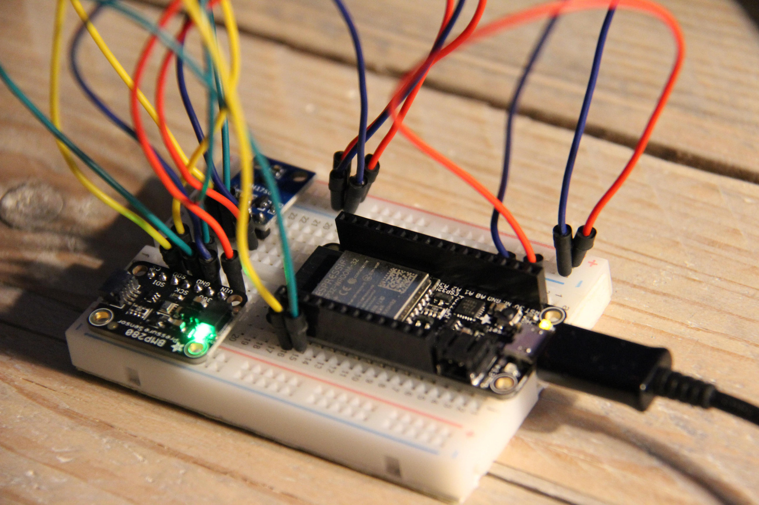
ADVANTAGES
OF USING ESP32
High Performance: Dual-core 32-bit CPU at 240 MHz and approximately 520 KB of SRAM enable complex tasks and multitasking under FreeRTOS.
Integrated Wireless: On-board Wi-Fi and Bluetooth support reduces BOM and simplifies IoT integration .
Rich I/O & Peripherals: Abundant GPIOs, ADC channels, capacitive touch sensors, hardware PWM, and multiple serial interfaces .
Low Cost: ESP32 dev-boards are available for around USD 6, offering strong performance per dollar.
Extensible Ecosystem: Compatible with Arduino IDE, PlatformIO, and Espressif’s ESP-IDF, backed by an active community .

Slide 12
PAPER(1)
REFRENCE
DESCRIPTION | ANALYSIS | ADVANTAGES | DISADVANTAGES | DESIGN & IMPLEMENTATION
An access-control system using dual authentication: voice recognition and RFID card. Designed as a low-cost automated replacement for mechanical locks in small/medium offices.
Opens the door automatically upon identity verification.
The aim of this developed system is to restrict the access of an office/location using Radio Frequency Identification (RFID) and voice recognition authentication, thus offering security to the lives and properties of people.
Hardware:
Arduino Uno
RFID reader (RC522) + active tags (~200 mm read range)·
Voice-recognition module(5 V; Tx→D2,Rx→D3)
PIR motion sensor → D7 on Arduino
16x2 LCD via 12C (SCL→A5, SDA→ A4)
Solenoid lock + relay + servo
motor to open door for 5s
Power: SMPS 12 V
buck converter to 5 V
+12 V rechargeable battery backup authentication to increases security.
Prevents unauthorized access, thereby safeguarding lives and property.
Automates authentication (recognition, authorization), ensuring complete protection.
Simplifies entry for authorized personnel and eliminates the need for security guards.
Reduces data breaches and theft by granting access only to trusted users
Eliminates carrying multiple physical keys—RFID tags work non‑line‑of‑sight and can be read in bulk
Voice biometrics are unique to each individual and cannot be stolen
Dual‑factor design provides a secure RFID fallback when voice recognition is impaired
Voice recognition is unreliable in noisy environments or when the user is ill
RFID cards can be easily lost or stolen
RFID has a short read range (~20 cm), requiring close proximity
PIR sensor may trigger falsely due to pets or heat sources
No internal memory or database to log access events
Lacks multi-factor fallback (e.g. no PIN or fingerprint option)
Arduino lacks built-in Wi-Fi or memory—ESP32 could offer better storage, wireless logging, and expansion options
Startup: LCD shows
ACCESS CONTROL SYSTEM AUTHENTICATED BY RFID AND VOICE RECOGNITION
Motion detected (PIR): LCD → “WELCOME” then “SPEAK”
Voice verification:
If match → LCD “ACCESS GRANTED” / “WELCOME, USER”; energize relay → solenoid unlocks → servo opens door
Else → LCD “SWIPE CARD”
RFID verification: reader scans tag (≤200 mm) via serial link
If UID match → LCD “ACCESS GRANTED” / “WELCOME, USER”; unlock and open as above
If no match → LCD “ACCESS NOT GRANTED”; door remains locked
Auto‑close: servo shuts door after 5 seconds

Slide 13
PAPER(2)
REFRENCE
DESCRIPTION | ANALYSIS | ADVANTAGES | DISADVANTAGES | DESIGN & IMPLEMENTATION
A smart locker security solution using loT + Machine Learning+ Cloud.
Combines biometric (face + fingerprint) and traditional (PIN) authentication.
Uses image processing techniques like Viola-Jones and Gabor Filters.
Sends real-time alerts via Telegram & SMS.
Integrated with safety sensors (fire/smoke).
Hardware:
Arduino Uno, LCD, R305 Fingerprint Scanner.
PIR, Fire/Smoke Sensors, Camera.
Buzzer, WiFi Module.
Software:
Face recognition (OpenCV + Haar).
Fingerprint authentication, OTP via Telegram.
Image matching uses GLCM(texture analysis) and HOG (feature orientation).
Smart decision logic for access validation.
Buzzer and message alert for unauthorized attempts.
monitoring through loud + logging system.
Multi-layered security using face recognition + fingerprint + PIN/ OTP.
Real-time alerts through Telegram/SMS in case of unauthorized access.
Highly accurate face detection using OpenCV, Haar Classifier, and Gabor filters.-Suitable for home, bank, and enterprise environments.
Cloud-based storage and real-time image Comparison.
Eliminates physical keys, reducing risk of loss or duplication.
Cost-effective and scalable for various security setups.
Can be used by visually impaired individuals since iris remains unaffected.
Uses human-vision-like algorithms (Gabor filters) to enhance recognition accuracy even with slight image differences.
System relies on stable internet for real-time cloud access and alerts.
False positives/negatives possible in facial recognition due to lighting, angles.
Fingerprint sensor may fail with wet/dirty fingers.
Needs clean facial dataset in cloud for accuracy.
Telegram/SMS alerts may not be received if network is down.
Not ideal for rugged industrial use without adaptation.
System activates sensors and Arduino Uno at startup.
PIR sensor detects motion; camera captures the intruder’s image.
Captured face is compared with cloud-stored images using Haar Classifier.
If face matches, fingerprint verification is requested via R305 sensor.
If both are verified, the locker unlocks.
If not, Telegram alert is sent, and OTP or password is required.
Buzzer is triggered for unauthorized attempts.
Fire and smoke sensors monitor environment and send alerts.
All events are logged in the cloud.

Slide 14
PAPER(3)
REFRENCE
DESCRIPTION | ANALYSIS | ADVANTAGES | DISADVANTAGES | DESIGN & IMPLEMENTATION
The Smart Bank Security System using ESP32 is an IoT-based project that provides intelligent surveillance and real-time monitoring for a bank setup. It utilizes the ESP32 microcontroller, multiple sensors, and a web-based dashboard to detect breaches and send alerts.
The system operates in two modes:
Day Mode: Normal operation with restricted access to the vault via a PIN-authenticated keypad.
Night Mode: Full lockdown; any unauthorized entry triggers alerts.
This system simulates a secure environment using multiple sensors to monitor different areas (Counter, Employee, Vault). It demonstrates how IoT and microcontrollers like the ESP32 can be effectively used in real-time security systems.
Key features:
Web-based monitoring via ESP32 WebServer
PIN authentication using 4x4 Keypad for vault access
Visual alerts using an I2C LCD
Mode switching (Day/Night) to adapt security levels
Real-Time Monitoring: Data is uploaded instantly to the server interface.
Internet Connectivity: ESP32 enables remote alerts and web interface.
Modular Design: Different sections (Vault, Employee, Counter) can be customized.
Interactive UI: Web interface and LCD provide a user-friendly experience.
Secure Access: Vault protected with PIN authentication.
Limited to Local WiFi: System depends on the WiFi range of the ESP32.
Basic Authentication: PIN system is vulnerable without encryption.
Single-point Failure: ESP32 failure would halt the entire system.
No Database: Data is not stored or logged permanently.
System Design:
ESP32 acts as the brain, collecting sensor data and controlling modules.
IR Sensors monitor physical presence or breaches at key entry points.
Fire and Smoke Sensors provide safety alerts.
4x4 Keypad is used for user authentication for vault access.
I2C LCD displays status messages (e.g., vault status, alerts).
Web Server hosted on ESP32 shows real-time sensor data and control buttons for Day/Night modes

Slide 15
PAPER(4)
REFRENCE
DESCRIPTION | ANALYSIS | ADVANTAGES | DISADVANTAGES | DESIGN & IMPLEMENTATION
The paper proposes an IoT-based multi-layered bank security system
It aims to replace conventional security with a cost-effective, automated solution for small/medium banks.
Hardware:
Microcontrollers: Arduino Uno (logic), NodeMCU (Wi-Fi).
Sensors: IR, ultrasonic, PIR (motion/temperature).
Cameras: ESP32 module (live video + OpenCV for face detection).
Authentication: Fingerprint sensor (R307), RFID (RC522).
Actuators: Servo (door control), buzzer, LED.
Power: 230V to 5V converter (transformer + rectifier + regulator).
Software:
Arduino IDE (C++ for firmware).
Lua/Python (NodeMCU scripting).
Multi-layered security: Combines biometrics, sensors, and cameras.
Real-time monitoring: ESP32 streams video to a web server.
Scalability: Modular design (supports additional sensors).
Cost-effective: Uses affordable components (Arduino)
Remote alerts: Notifications via email/SMS
·
Limited range: IR/ultrasonic sensors work only within short distances.
Power dependency: Requires stable 5V supply.
Complexity: Integration of multiple protocols (SPI, I2C, UART).
False alarms: Environmental factors (e.g., heat) may trigger PIR sensors
Access Control:
Employees authenticate via fingerprint/RFID/keypad.
Servo unlocks doors upon validation.
Intrusion Detection:
IR/ultrasonic sensors detect unauthorized entry → trigger buzzer/LED.
PIR monitors motion in restricted areas.
Surveillance:
ESP32 camera captures live footage; motion detection alerts security.
OpenCV processes images for facial recognition.
Microcontrollers:
Arduino interfaces with sensors (I2C/SPI) and LCD.
NodeMCU handles Wi-Fi (connects to Cayenne IoT for cloud logging).

Slide 16
PAPER(5)
REFRENCE
DESCRIPTION | TECH/ANALYSIS | ADVANTAGES | DISADVANTAGES | DESIGN & IMPLEMENTATION
The Smart Banking Security System enhances bank locker security using advanced technologies like Face Recognition, RFID, GSM, and sensors. It ensures only authorized individuals can access lockers.
Face Recognition: Biometric identification to verify user identity.
RFID: User authentication through RFID tags.
GSM: Sends alerts to the bank manager for unauthorized access.
Sensors: Vibration and temperature sensors detect security breaches.
User Authentication: Users present RFID tags; face recognition captures and verifies identity.
Security Measures: Vibration and temperature sensors trigger alerts and a timer locks the locker if access exceeds a set duration.
Communication: GSM module sends alerts.
Enhanced Security: Reduces unauthorized access risks.
Real-time Alerts: Immediate notifications improve response time.
User-Friendly: Minimal action needed for authorized users.
Cost-Effective: Reduces costs associated with theft.
Technical Complexity: Integration of multiple technologies can complicate implementation.
False Positives/Negatives: Face recognition may inaccurately identify users.
Dependence on Technology: Reliability depends on proper functioning of components.
Privacy Concerns: Biometric data raises privacy issues.
Block Diagram: Visual representation of system architecture.
Microcontroller Integration: Uses PIC and ARM microcontrollers for processing.
Software Development: Developed in Embedded C, programmed into microcontroller.
Testing and Calibration: Rigorous testing for sensor thresholds and performance metrics

Slide 17
PAPER(6)
REFRENCE
DESCRIPTION | ANALYSIS | ADVANTAGES | DISADVANTAGES | DESIGN & IMPLEMENTATION
A multi-layered security system for bank lockers combining RFID authentication, face recognition (Viola-Jones/PCA), GSM alerts, and sensors (vibration/temperature). Automatically locks after timeout.
Flow: RFID → Face recognition → Access grant.
Sensors: Trigger GSM alerts for tampering/fire.
Hardware: PIC (RFID), ARM (face processing), SIM900A (GSM).
Software: MATLAB (image processing), Embedded C (microcontrollers).
Enhanced Security: Dual authentication (RFID + biometrics).
Real-time Alerts: GSM notifies manager during breaches.
Cost-Effective: Uses off-the-shelf components.
Automation: Timer limits access duration.
RFID Vulnerability: Lost/stolen tags risk unauthorized access.
Lighting Dependence: Face recognition may fail in low light.
False Alarms: Sensors sensitive to environmental noise.
Power Reliance: System fails during outages.
RFID Reader: PIC microcontroller (serial communication).
Camera: Face capture → MATLAB processing → ARM verification.
Sensors: Vibration/temperature thresholds trigger GSM via ARM.
Timer: Auto-lock via PIC/ARM.

Slide 18
PAPER(7)
REFRENCE
DESCRIPTION | ANALYSIS | ADVANTAGES | DISADVANTAGES | DESIGN & IMPLEMENTATION
This IoT-based bank security system enhances locker room protection using the ESP32 microcontroller. It employs the EM-18 RFID reader for card authentication, IR sensors for motion detection, and voice control for secondary verification. The Blynk app provides remote monitoring of locker status (open/closed) and sends alerts for unauthorized access. A 16x2 LCD displays status, and a buzzer sounds during operations or alerts. Designed for banks and secure environments, it ensures only authorized access and logs user activity.
The system’s multi-factor authentication (RFID + voice) offers stronger security than traditional locks or single-factor systems, with Blynk enabling remote oversight. It surpasses GSM-based systems by integrating IoT and voice control. However, voice control reliability is unclear due to missing implementation details, and RFID systems risk spoofing without robust encryption. Wi-Fi dependency and untested scalability for large banking networks are concerns, as is the lack of cybersecurity specifics.
Multi-factor authentication (RFID + voice) ensures high security.
Cost-effective with low-cost ESP32, passive RFID, and Blynk.
Remote monitoring via Blynk app enhances oversight.
Compact, low-power, and standalone for easy deployment.
Logs user access for audits; buzzer/LCD provide local feedback.
IR sensors optimize scanner operation, saving power.
Wi-Fi dependency limits use in poor network areas.
Voice control reliability and implementation unclear.
RFID spoofing and lack of encryption details pose security risks.
Scalability for large-scale banking untested.
Maintenance needed for RFID cards and sensors.
Single-point failure risk if ESP32/RFID reader malfunctions.
Hardware: ESP32 DevKit V1, EM-18 RFID reader (125 kHz), passive RFID cards, IR sensors, 16x2 LCD, buzzer.
Software: Blynk app, Arduino IDE with Blynk library.
Process: IR sensors detect motion, activating RFID scanner. Valid RFID card prompts voice authentication; correct inputs open locker. Blynk app shows status (IN/OUT with green/red indicators), sends alerts. LCD displays card ID/status; buzzer sounds for operations/alerts. Tested for authentication and door control, ensuring secure access and real-time monitoring.

Slide 19
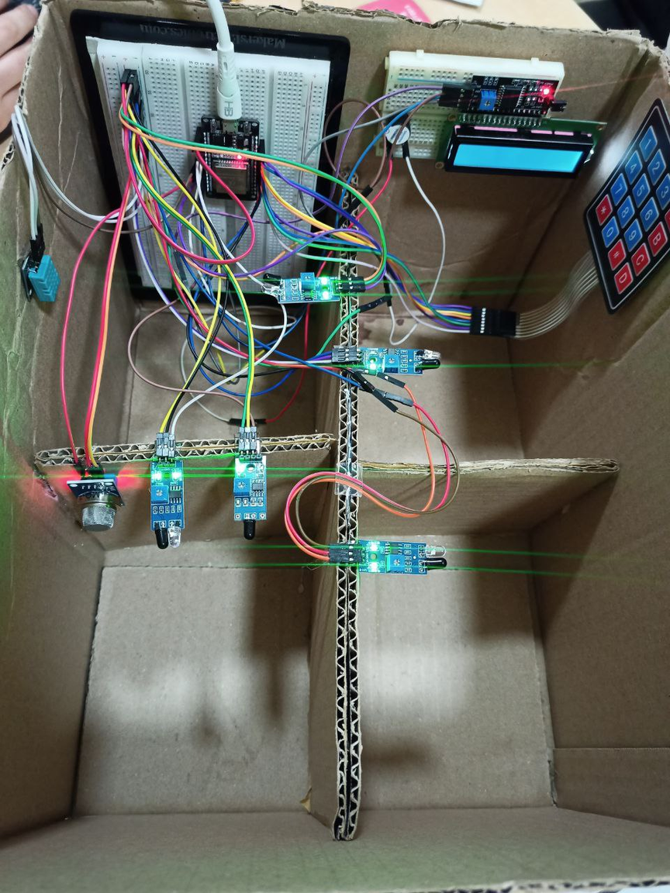

SECTIONS
OUR SYSTEM
Counter
(IR ,Smoke,Fire sensor )
Vault
(IR sensor,LCD, keypad)
Employee
(IR sensor)
Server
(IR & DHT11 sensor, ESP)

Slide 20
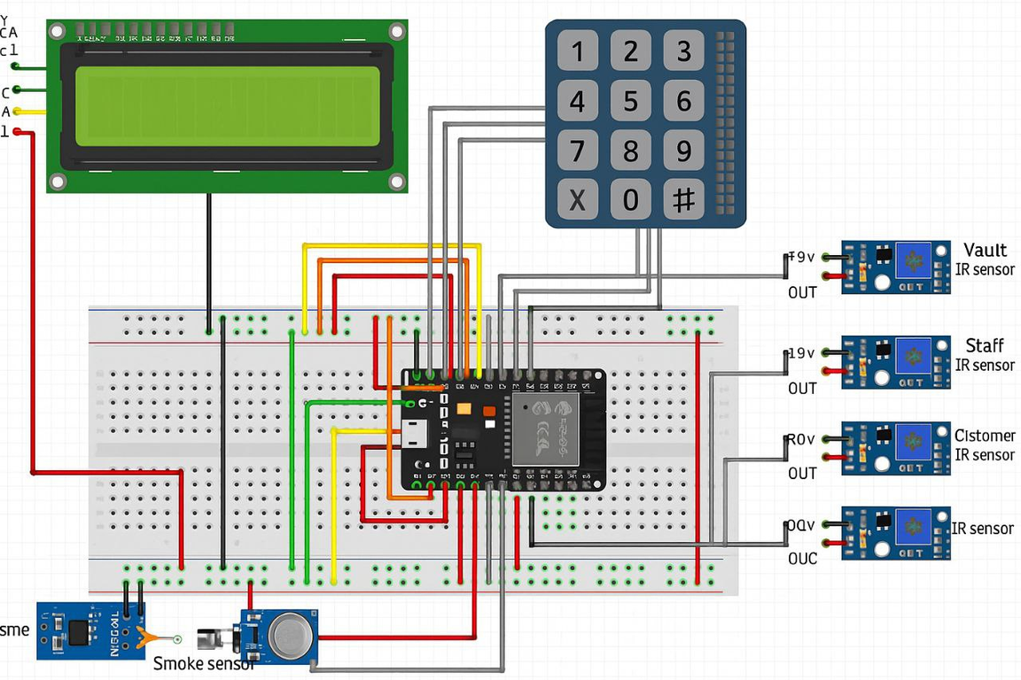
D2 → Buzzer
D4 → Server IR
D5 → DHT11
D18 → Smoke sensor
D19 → Vault IR
D21 → SDA
D22 → SCL
D23 → Fire Sensor
D13 → Row1
D12 → Row2
D14 → Row3
D27 → Row4
D26 → Column1
D25 → Column2
D33 → Column3
D32 → Column4
D35 → Employee IR
D34 → Counter IP
ESP32
PINS

Slide 21
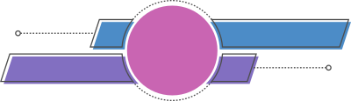
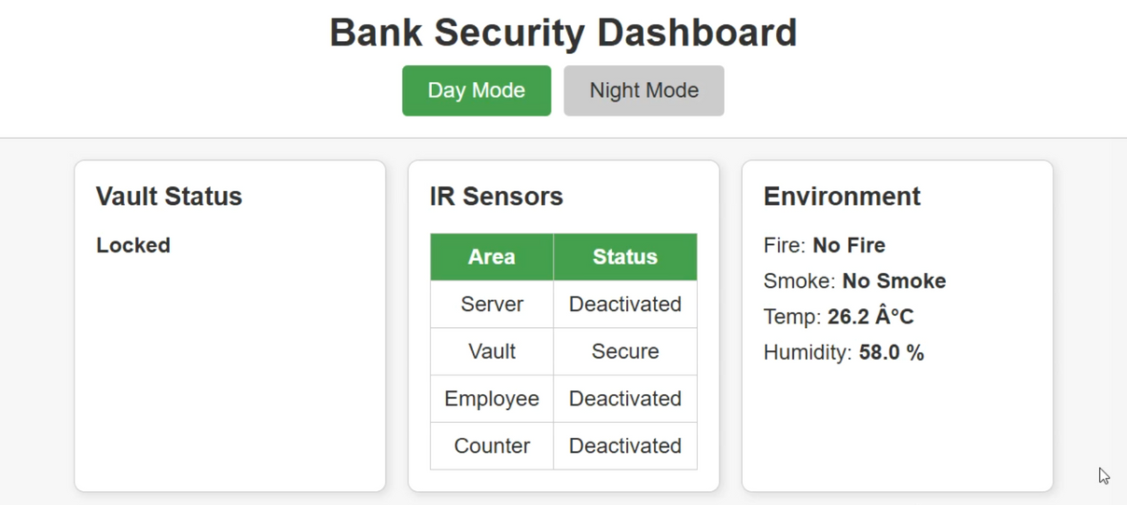
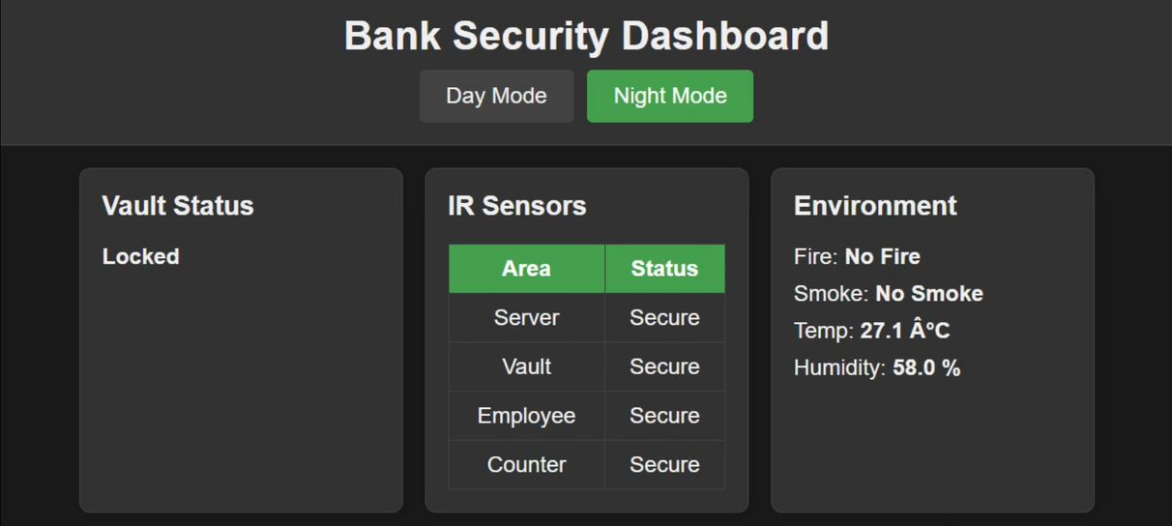
WEBSITE
OUR SYSTEM
Day
Modes
Night

Slide 22
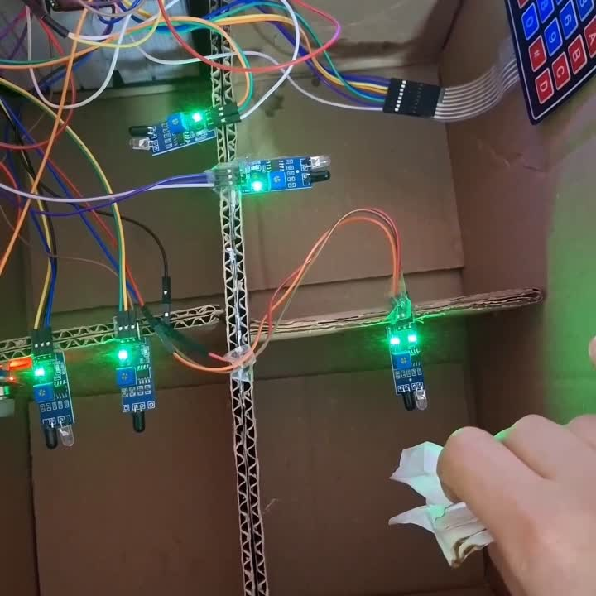
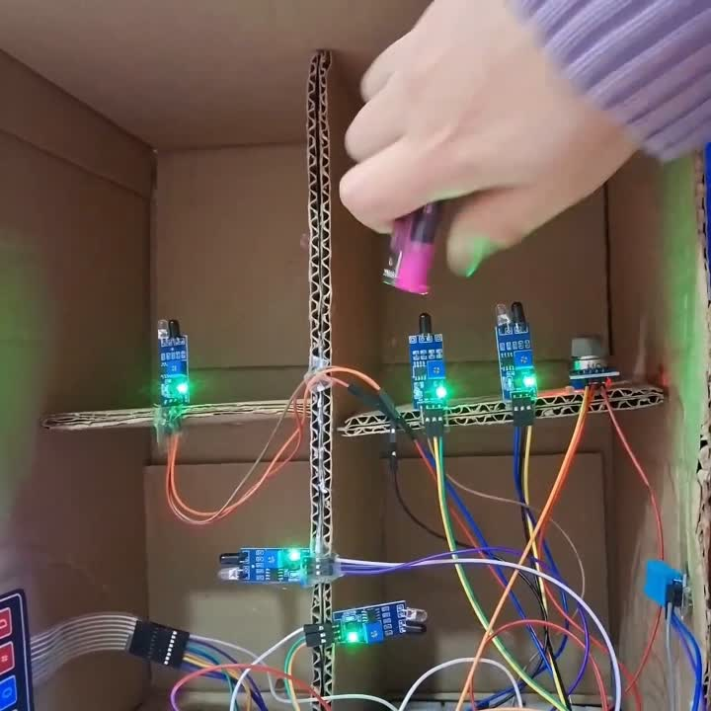
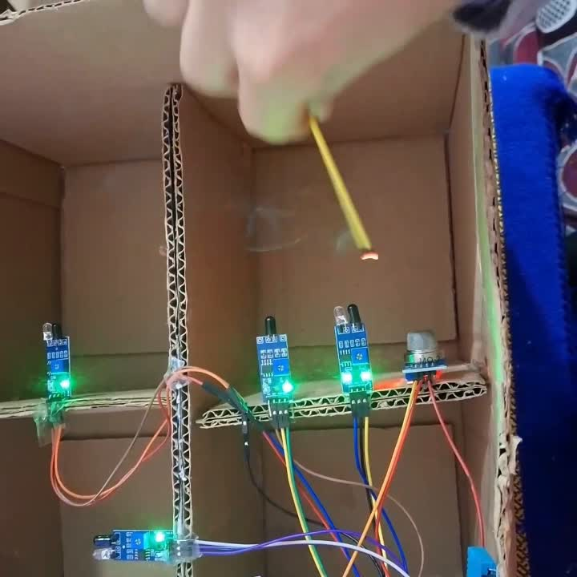
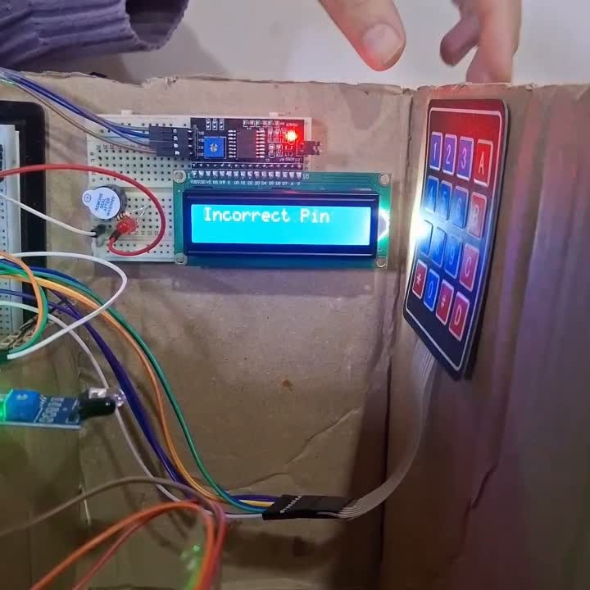
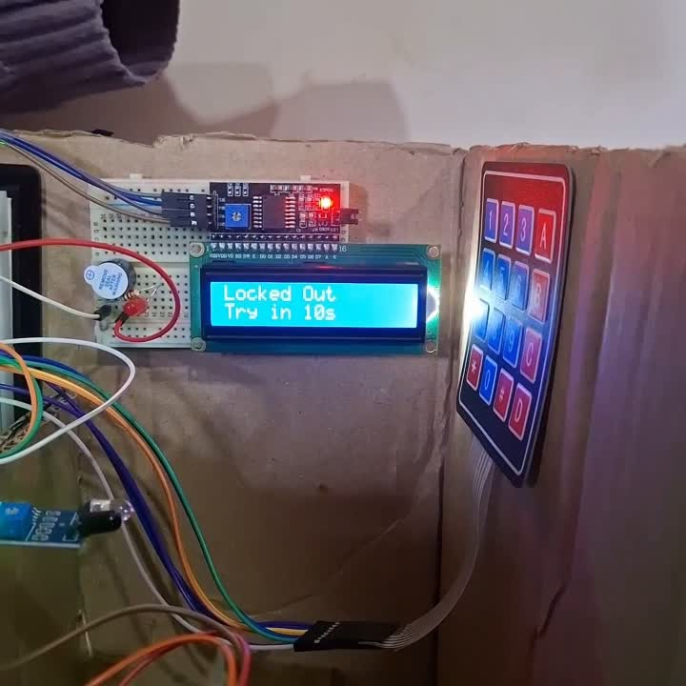
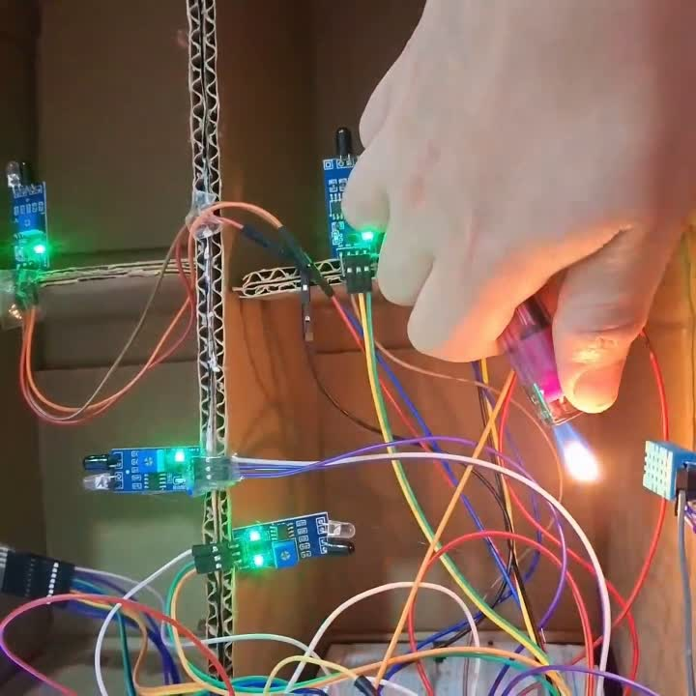
TEST
COMPONENTS
IR SENSOR
FIRE SENSOR
SMOKE SENSOR
KEYBAD & LCD
BUZZER
DHT11
video
video
video
video
video
video

Slide 23
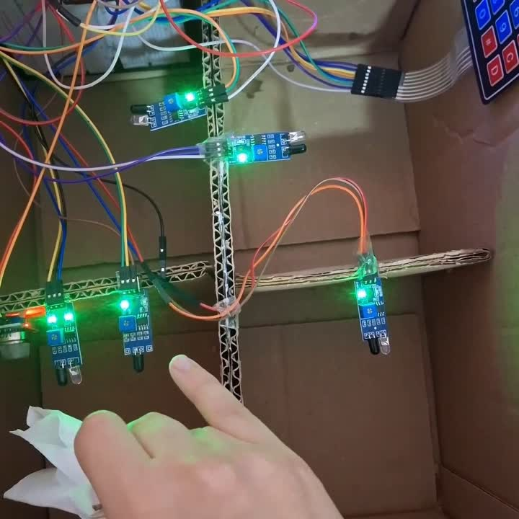
FINAL
video
RESULT

Slide 24
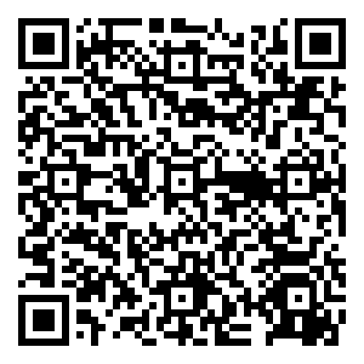
QR
CODE

Slide 25


Challenges
OF OUR SYSTEM
Power Supply Reliability
No Local Storage:
No Redundancy Mechanism
Continuous power is needed for the system to function effectively. In areas with power instability, this can be a major concern unless a battery backup is included.
Without an SD card or external memory module, the system may not store past logs locally if internet/cloud fails.
If a component like a sensor or ESP32 board fails, there might not be a backup system in place unless specifically implemented.

Slide 26


CONCLUSTION
This project successfully demonstrates the implementation of a smart and real-time bank security system using the ESP32 microcontroller and various sensors (fire, smoke, motion, temperature, and humidity). The system efficiently detects emergency situations and provides instant visual alerts via an LCD display. Throughout the development, we applied several concepts from the Organization course such as memory management, processor structure, input/output mechanisms, and computer arithmetic to build a reliable and responsive system.
The project emphasizes the importance of real-time embedded systems in enhancing safety and security in critical environments like banks. It also highlights how low-cost and power-efficient hardware like the ESP32 can be used to create scalable and smart security solutions.

Slide 27

FUTURE
microSD Logging: Add a cad slot for local storage of sensor events and video snapshots results in enabling offline audits and long-term record-keeping .
RFID-Based Multi-Factor Authentication: Integrate an MFRC522 so users must present both a registered card and a fingerprint or PIN result in raising security by layering credentials.
Cellular Backup: Use a SIM800L or Notecard for SMS alerts and connectivity if Wi-Fi drops.
On-Device AI: Upgrade to an ESP32-S3/S3-CAM with ML face detection to reduce false alarms.
Secure Boot & Encryption: Enable Espressif’s secure boot and flash encryption (or move to ESP32-H2).
Cloud & OTA: Connect via MQTT/HTTPS to AWS/Azure IoT for real-time dashboards and firmware updates.
Solar/UPS & Deep-Sleep: Implement solar/UPS power with intelligent deep-sleep scheduling for uninterrupted operation
WORK

Slide 28

REFERENCES
[1].M. A. Khan and S. A. Khan, "Door Access Control Using RFID and Voice Recognition System," ResearchGate, Mar. 2022.
[2].IoT Based Smart Bank Locker Security System Using Two-Way Authentication
[3].SMART BANK SECURITY SYSTEM USING EMBEDDED SYSTEM AND IOT, International Journal of Creative Research Thoughts (IJCRT), Vol. 11, No. 4, pp. 139–145, April 2023. https://ijcrt.org/papers/IJCRT2304139.pdf
[4].Smart Bank Locker Security System Using Biometric Fingerprint and GSM Technology https://drive.google.com/file/d/1oPMsotsNXeaPDzZize5I0DIdWw0mJYYM/view
[5].SMART BANKING SECURITY SYSTEM
[6].HQ Online, "Smart Bank Security System using ESP32." https://www.hqonline.com/blog/smart-bank-security-system-using-esp32
[7].R. Sharma and A. Patel, "Smart bank locker system using two-step authentication," in Proceedings of the 2020 International Conference on Emerging Trends in Information Technology and Engineering (ic-ETITE), Vellore, India, 2020, pp. 1–5.https://ieeexplore.ieee.org/document/9078655
[8].An IoT Based Bank Locker Security System, International Journal of Engineering Research & Technology (IJERT), Vol. 8, No. IS07, pp. 1–4, 2020. https://www.ijert.org/research/an-iot-based-bank-locker-security-system-IJERTCONV8IS07008.pdf
[9].P. K. Goyal, M. Giri, and S. Verma, "IoT-Based Smart Door Lock System with Face Recognition Using ESP32 CAM and Android App," in Lecture Notes in Electrical Engineering, vol. 1030, Singapore: Springer, 2024, pp. 365–376
[10].https://www.jetir.org/papers/JETIR2304A97.pdf
[11]. International Research Journal of Modernization in Engineering Technology and Science
[12].IOSR Journal of Electronics and Communication Engineering
[13].International Journal of Recent Technology and Engineering (IJRTE)

Slide 29
THANK
YOU

